Slide 1
LIFELINE

Slide 2
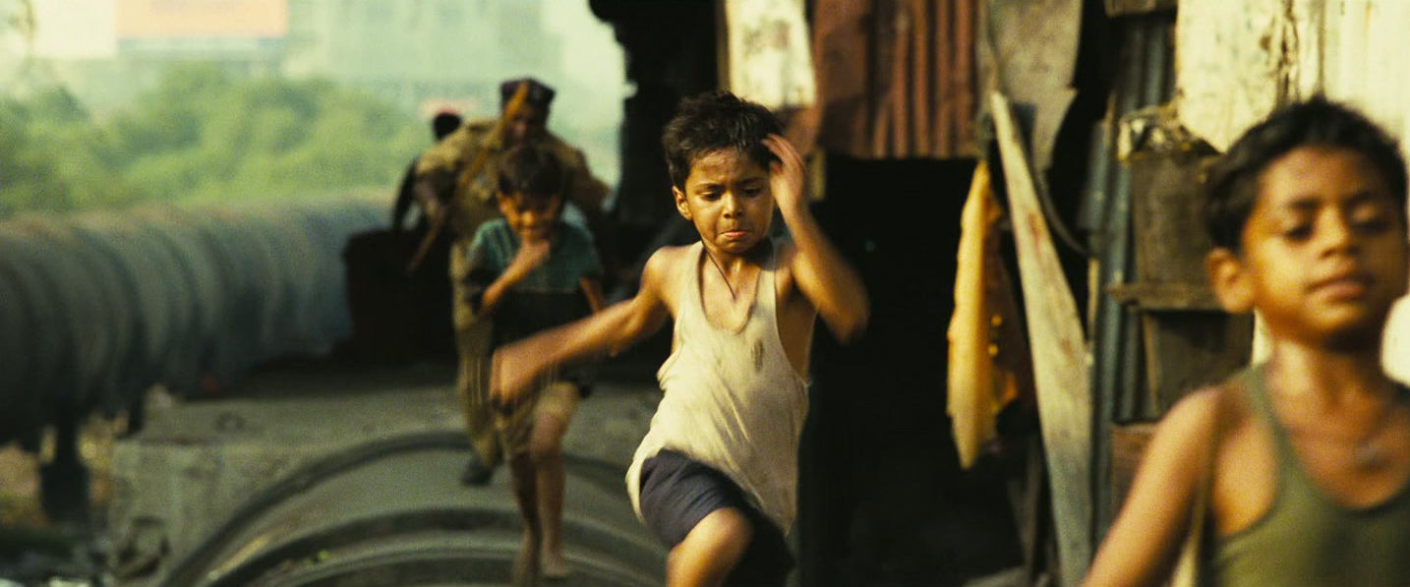
SLUM DOG MILLIONARE

Slide 3


Slide 4
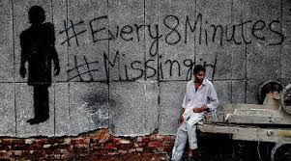
With instances where children just "disappear" overnight in some parts of India, as many as 1 every 8 minutes (according to National Crime Records Bureau data).

Slide 5

At last count, 200,000 Nepalese girls under the age of 16 were found to be actively
involved in prostitution in India.

Slide 6
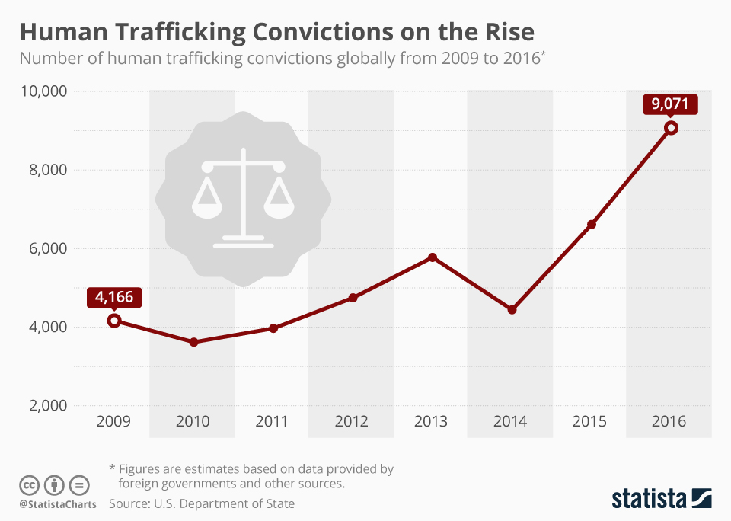

Slide 7


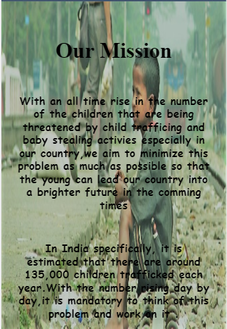

Slide 8
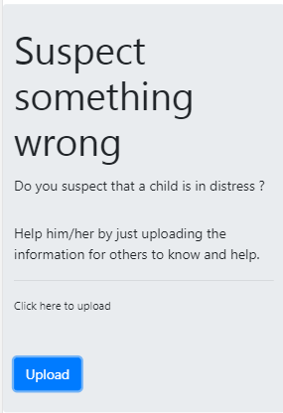


Slide 9
